Slide 1

Getting started,
Low hanging Fruit:
Our first xperiences at AMIS with Oracle Management Cloud
E
Lucas Jellema (CTO AMIS & Oracle ACE Director)
12th May 2017, Oracle Friday Cloud Update, Utrecht, The Netherlands

Slide 2
Situation and Challenge
Complex multi-tier, multi-node architecture and infrastructure
Fusion Middleware (ADF, BPM, SOA Suite, OSB, WebCenter Content) & Oracle Database
System performance below expectations and requirements
(occasionally) Long response times
Errors and exceptions
Degradation over time
Problems in monitoring and analysis
Identify (looming) problems
Analyze root cause
Across end-to-end, multi tier flows and throughout stack (application, platform, infrastructure)

Slide 3
Simplified view of application landscape
UI
API
Claim
Order
Complain
Review
Governance
Input -Scan & indexing
WebCenter Portal & ADF
Service Bus
BPM/ACM
Archive
SOA/BPM Suite
Document Generator
IAM
Output create document, print, send
WebLogic Server
Database

Slide 4
Research Questions
Insight into usage of application components
Who uses which components at which times?
Insight into the non-functional user experience
Which users of which components at which times experience long response times?
Which users of which components at which times experience instability (errors and exceptions)?
Insight into bottlenecks in the multi-tier architecture and infrastructure
Which steps in the underlying flow or end-to-end chain in underperforming user experiences cause long waits and/or exceptions?
Root Cause Analysis through drill down
What is the underlying cause – application, platform, infrastructure – of the bottleneck behavior?

Slide 5
Practical Approach in pilot
Trial access to OMC
Focus on Application Performance Monitoring and Log Analytics
Configure Agents (APM and Log Analytics) on WebLogic Servers and Database Server
Small software download, simple configuration, WLS domain restart

Slide 6
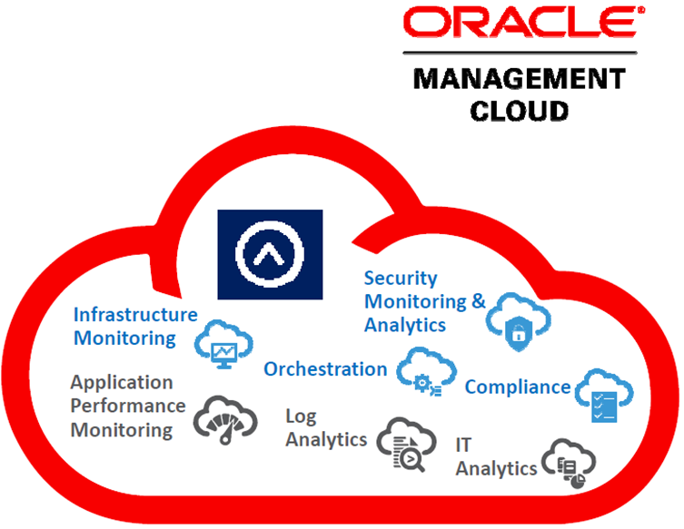
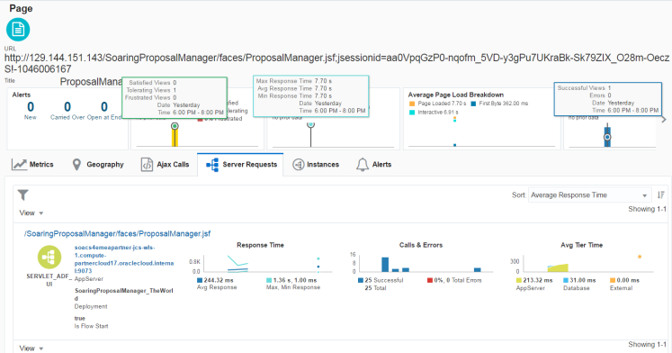
Pilot with OMC
FIREWALL
Claim
Order
Complain
Review
Governance
APM
APM
APM
APM
WebCenter Portal & ADF
Input -Scan & indexing
APM
LA
Service Bus
APM
BPM/ACM
LA
Archive
SOA/BPM Suite
APM
Document Generator
LA
APM
IAM
Output create document, print, send
APM
LA
WebLogic Server
APM
LA
Database
LA

Slide 7
Practical Approach in pilot
Trial access to OMC
Focus on Application Performance Monitoring and Log Analytics
Configure Agents (APM and Log Analytics) on WebLogic Servers and Database Server
Small software download, simple configuration, some OS skills and privileges, WLS domain restart
Use the application components
Metrics and logging are gathered by agents to APM and Log Analytics
Set appropriate log levels for application and platform
Explore findings to identify functional problem areas (& users & times)
Drill down to custom ADF components, services & SOA composites, Java Code & Database Queries and PL/SQL calls
Analyze Logging to find root cause

Slide 8
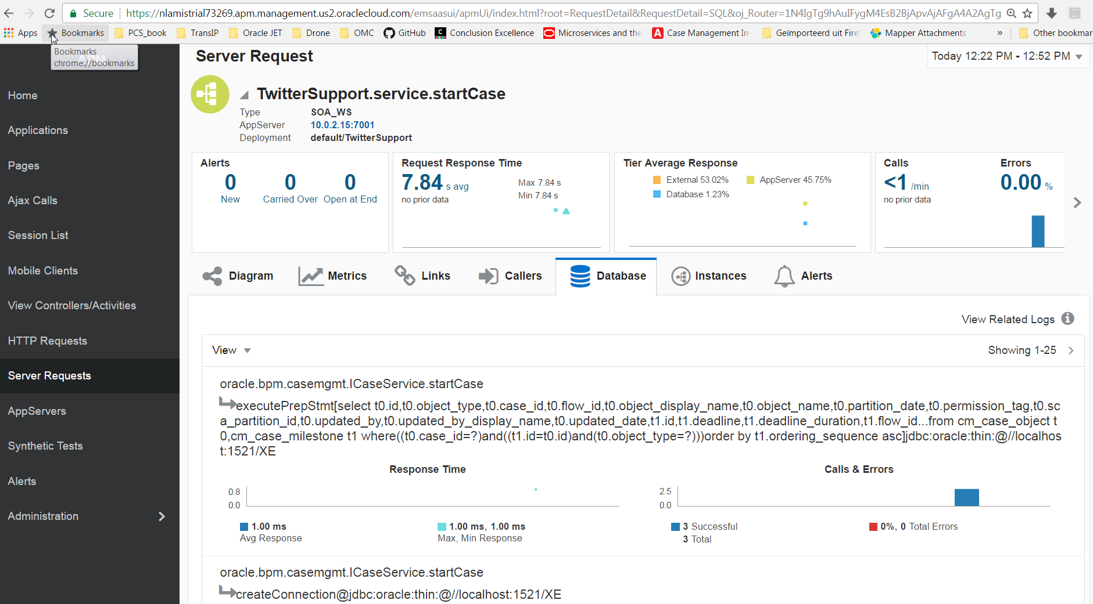
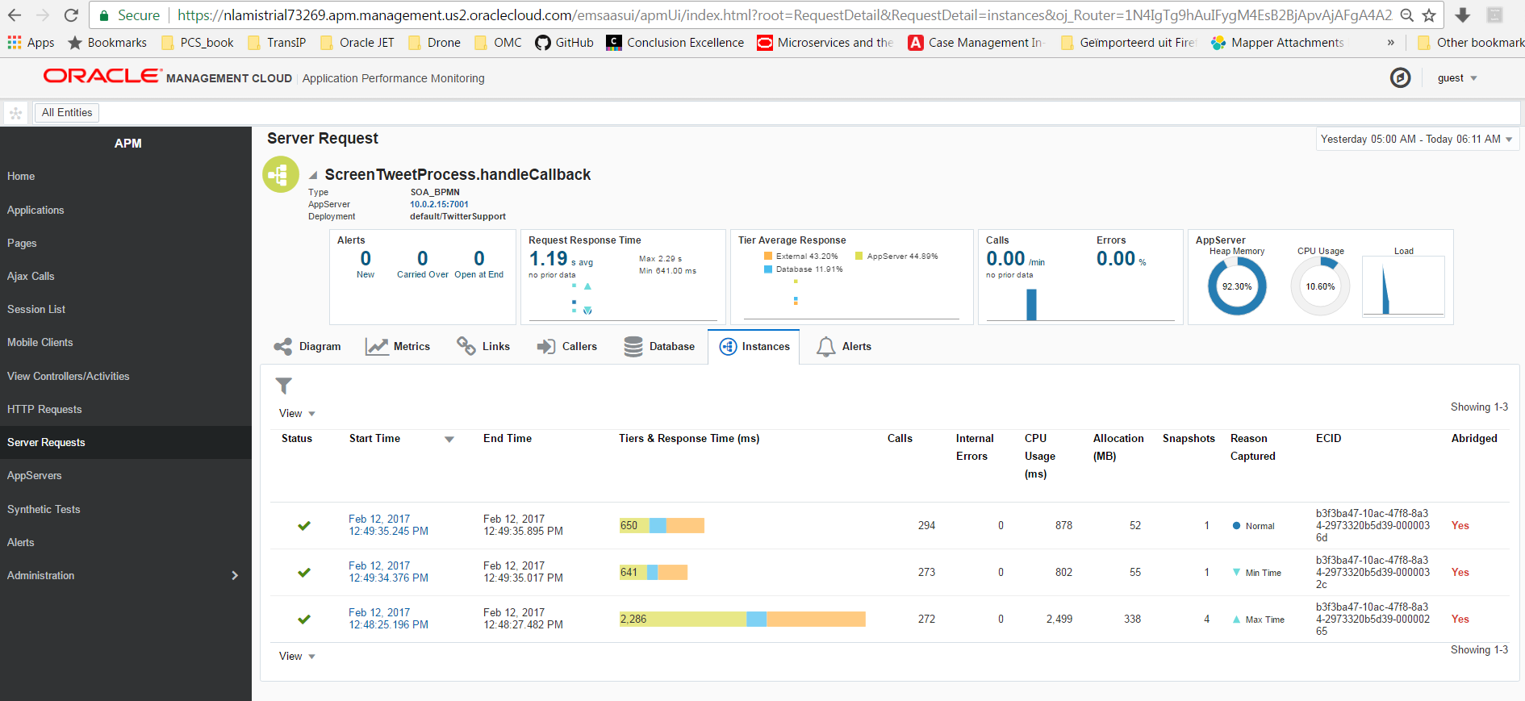
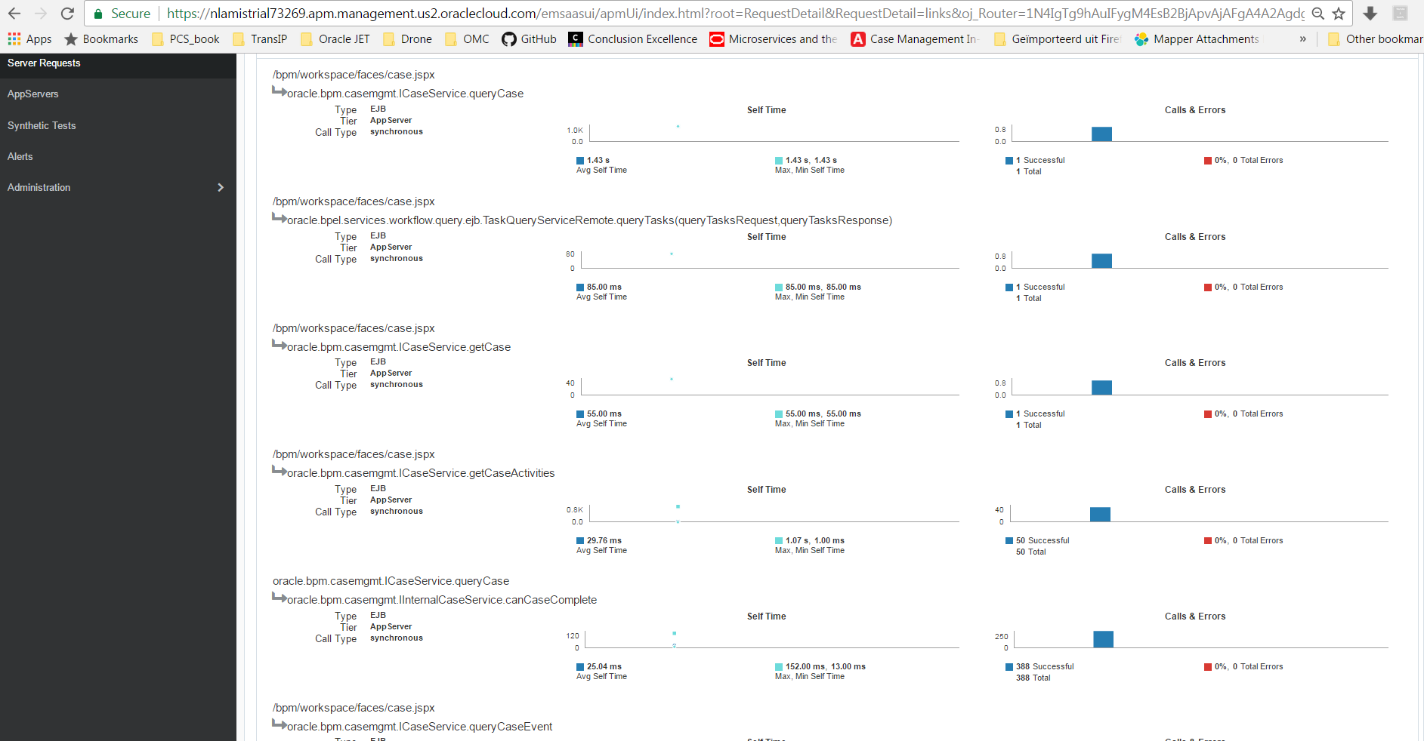
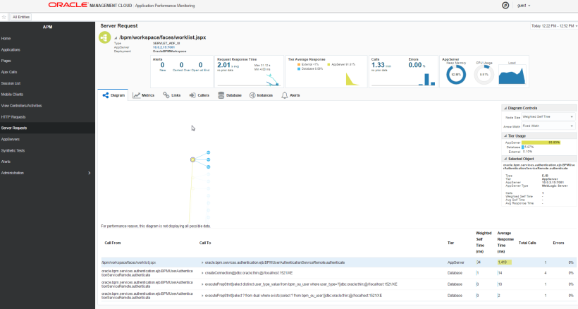
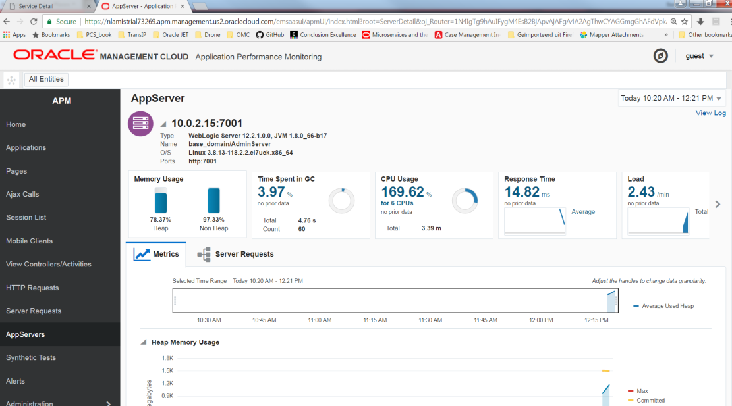
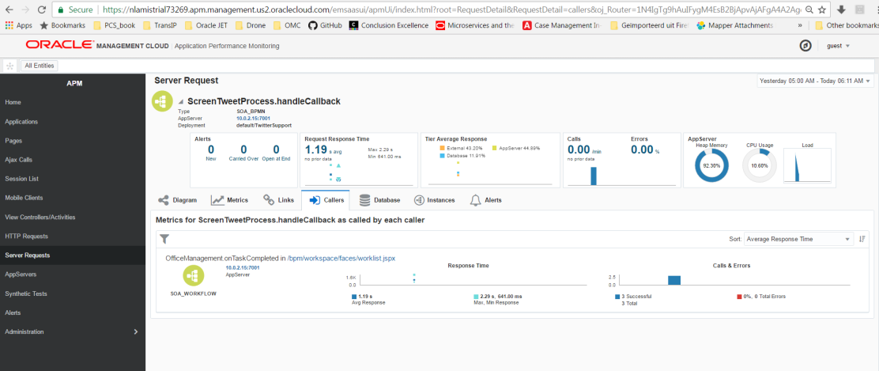
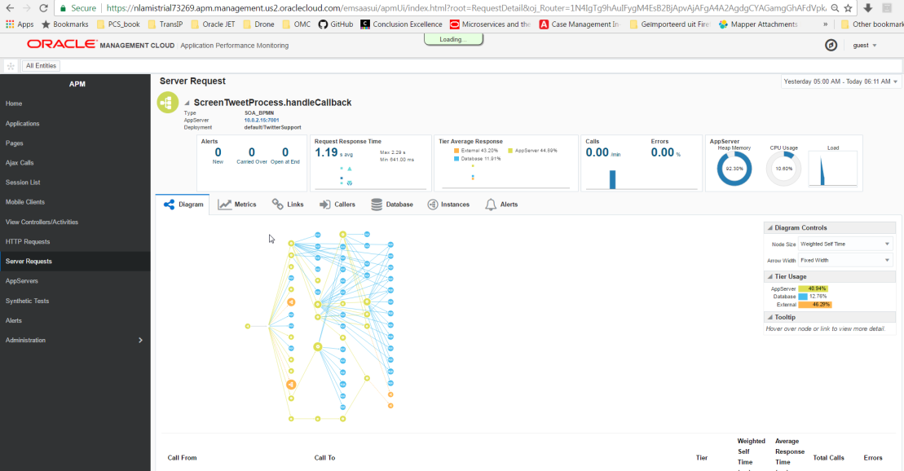
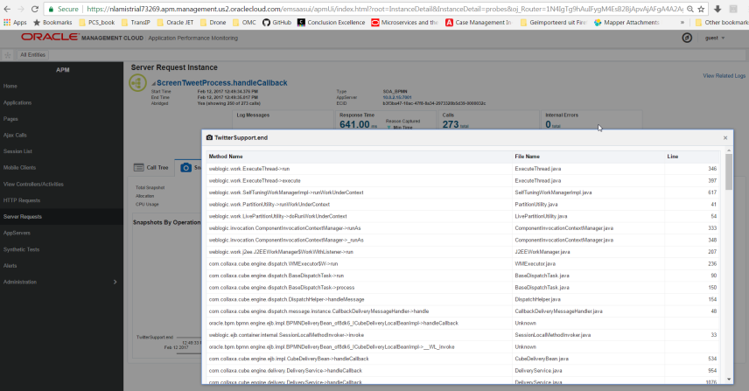
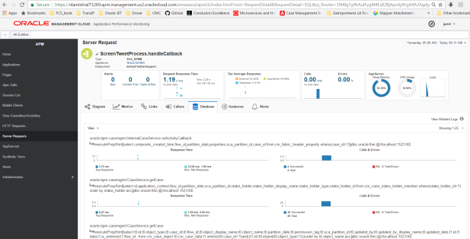
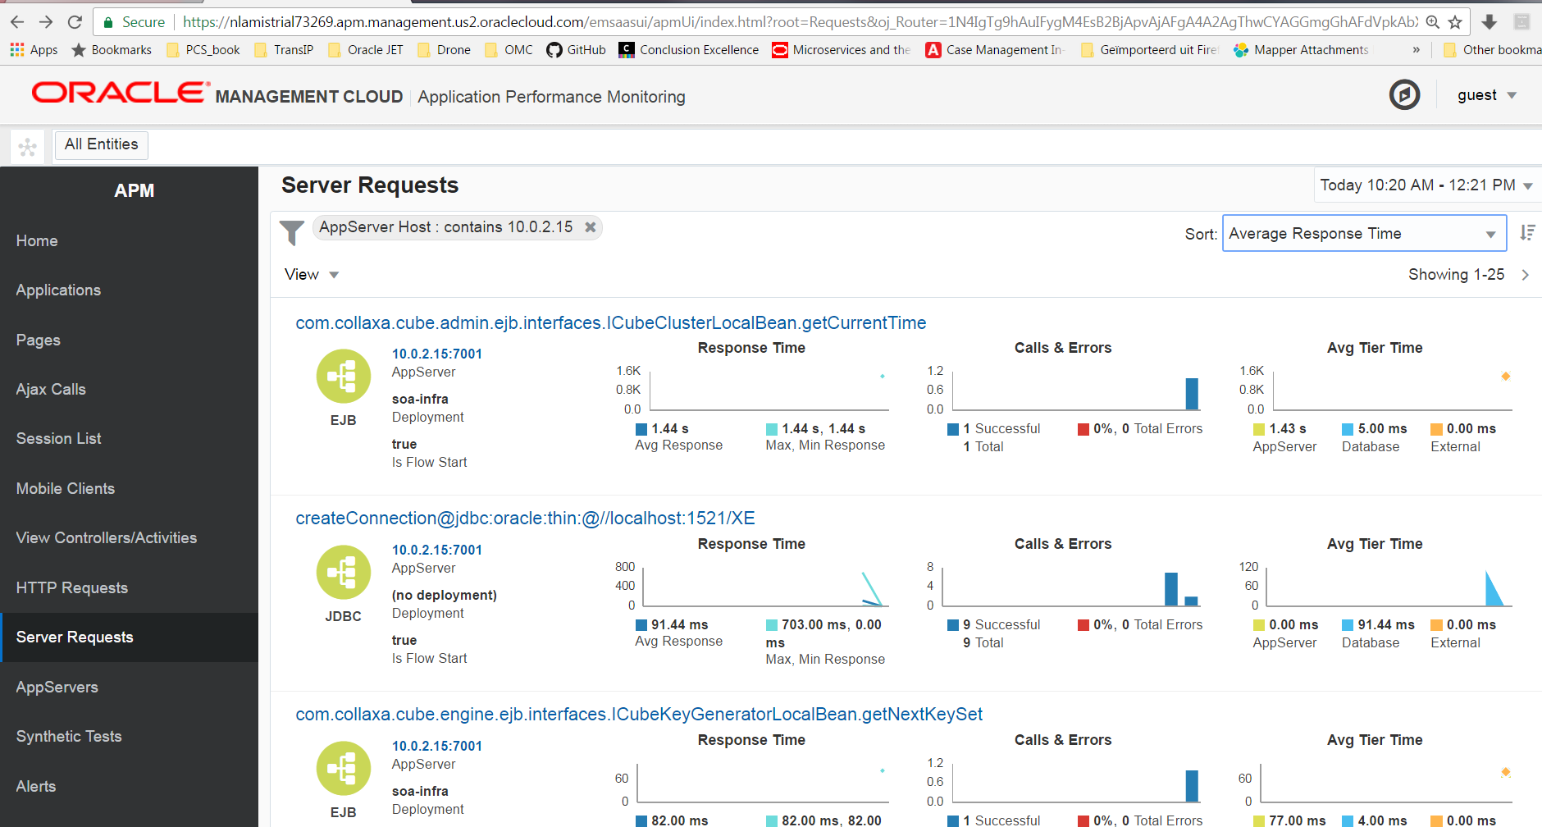
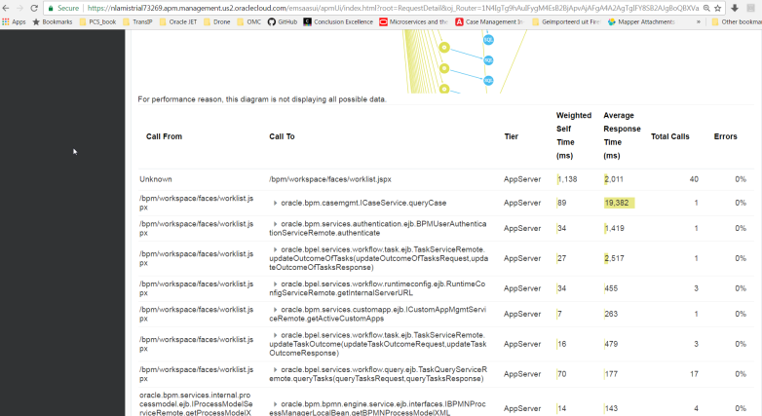
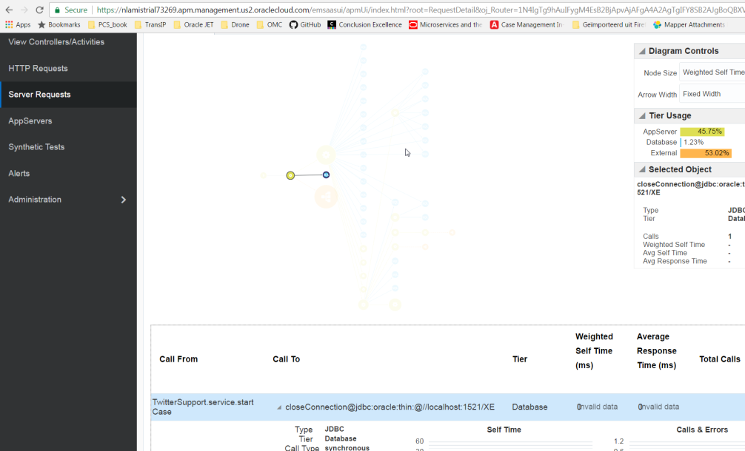
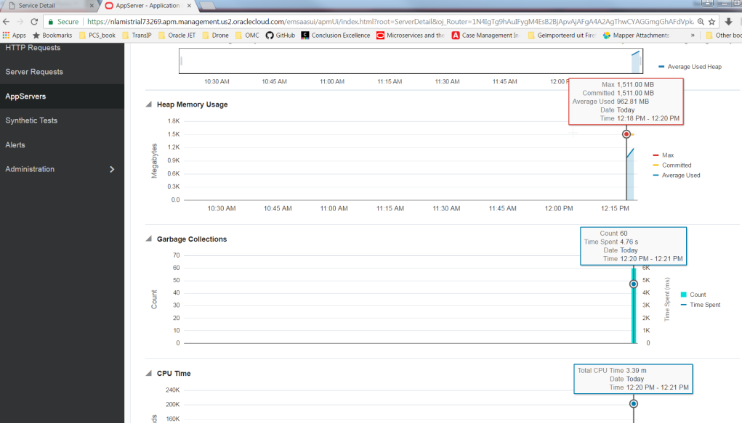
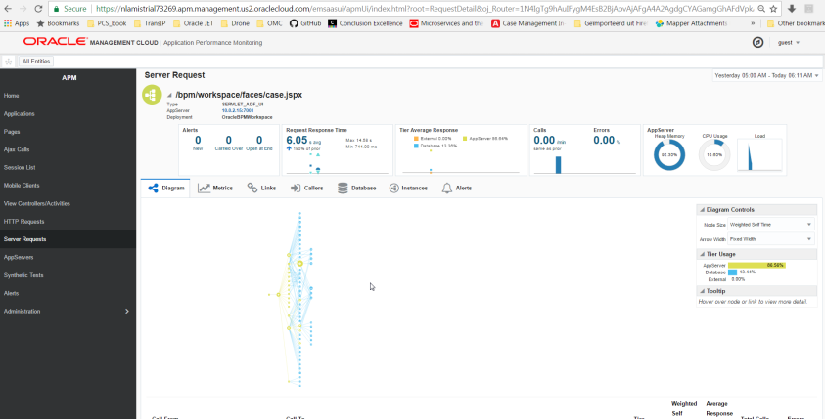
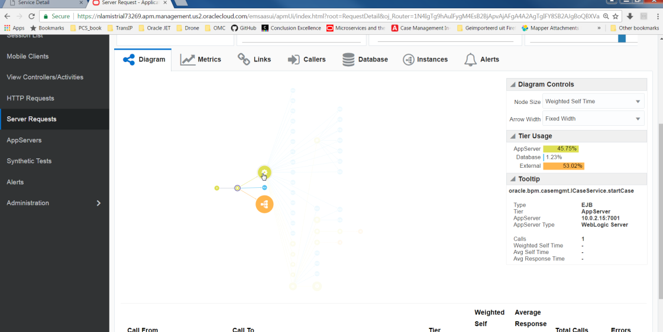
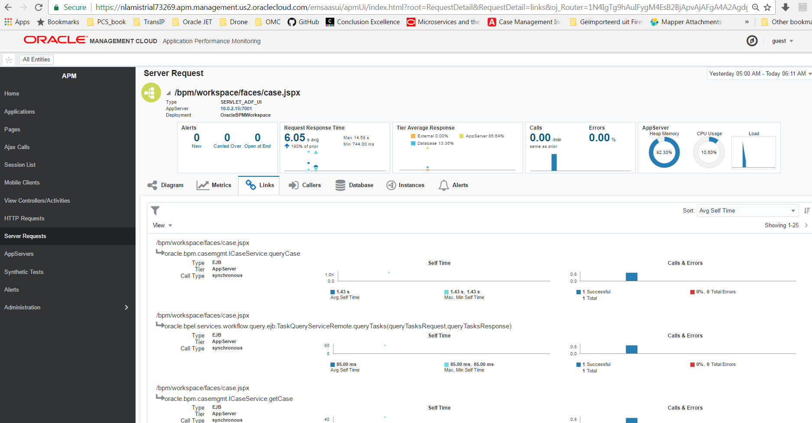
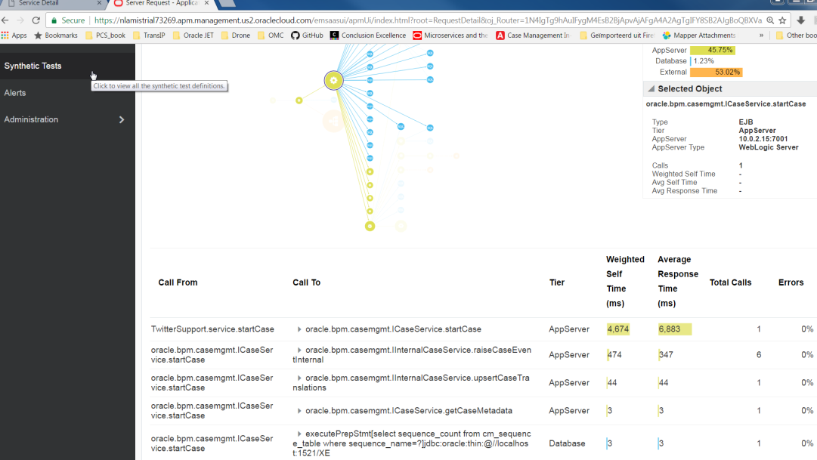
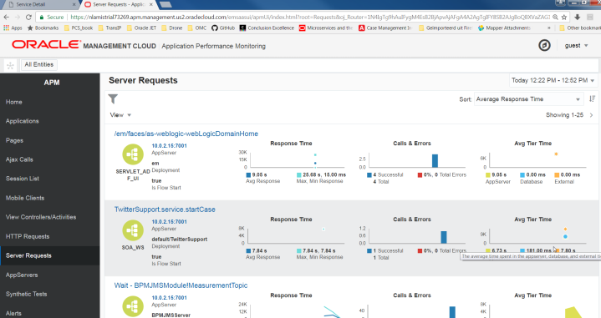
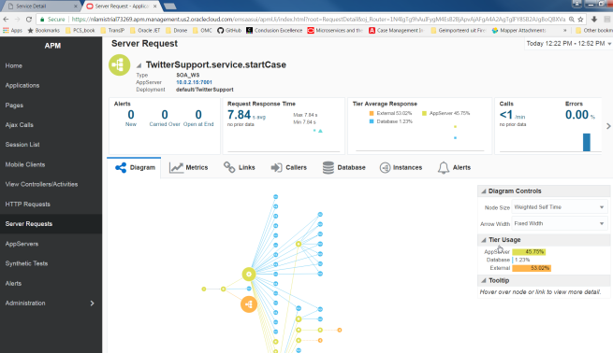
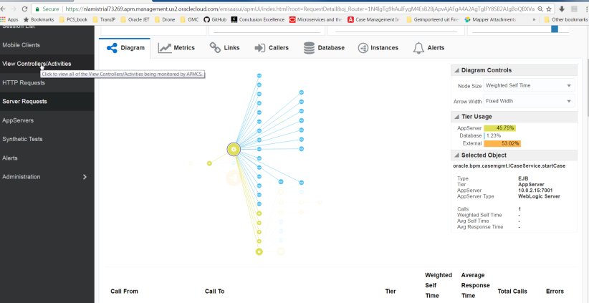
Screenshots from pilot

Slide 9
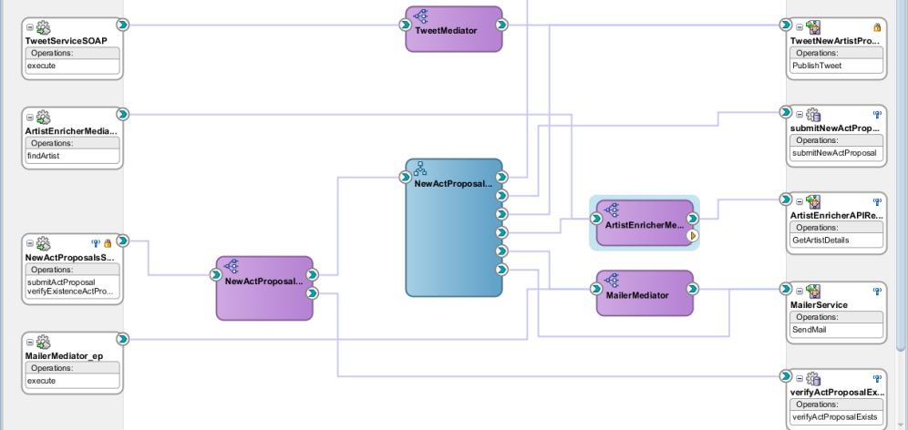
OMC knows Fusion Middleware

Slide 10
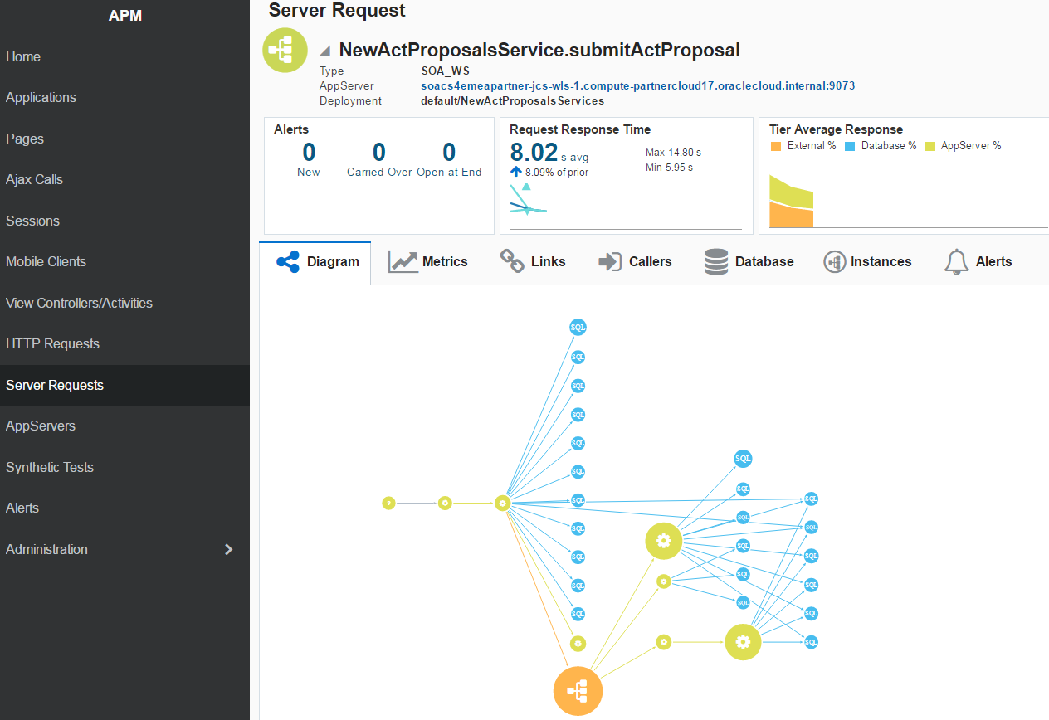

Slide 11


OMC: Gather the hay and find the needle(s)

Slide 12
Not part of Practical Approach in pilot
Arrange hardware
Acquire and install software
Configure network
Arrange access privileges
Hire expensive, hard to find experts to get going
=> complex decision making, long wait times, large investments, complete loss of momentum

Slide 13
Pilot was up and running
In an afternoon

Slide 14
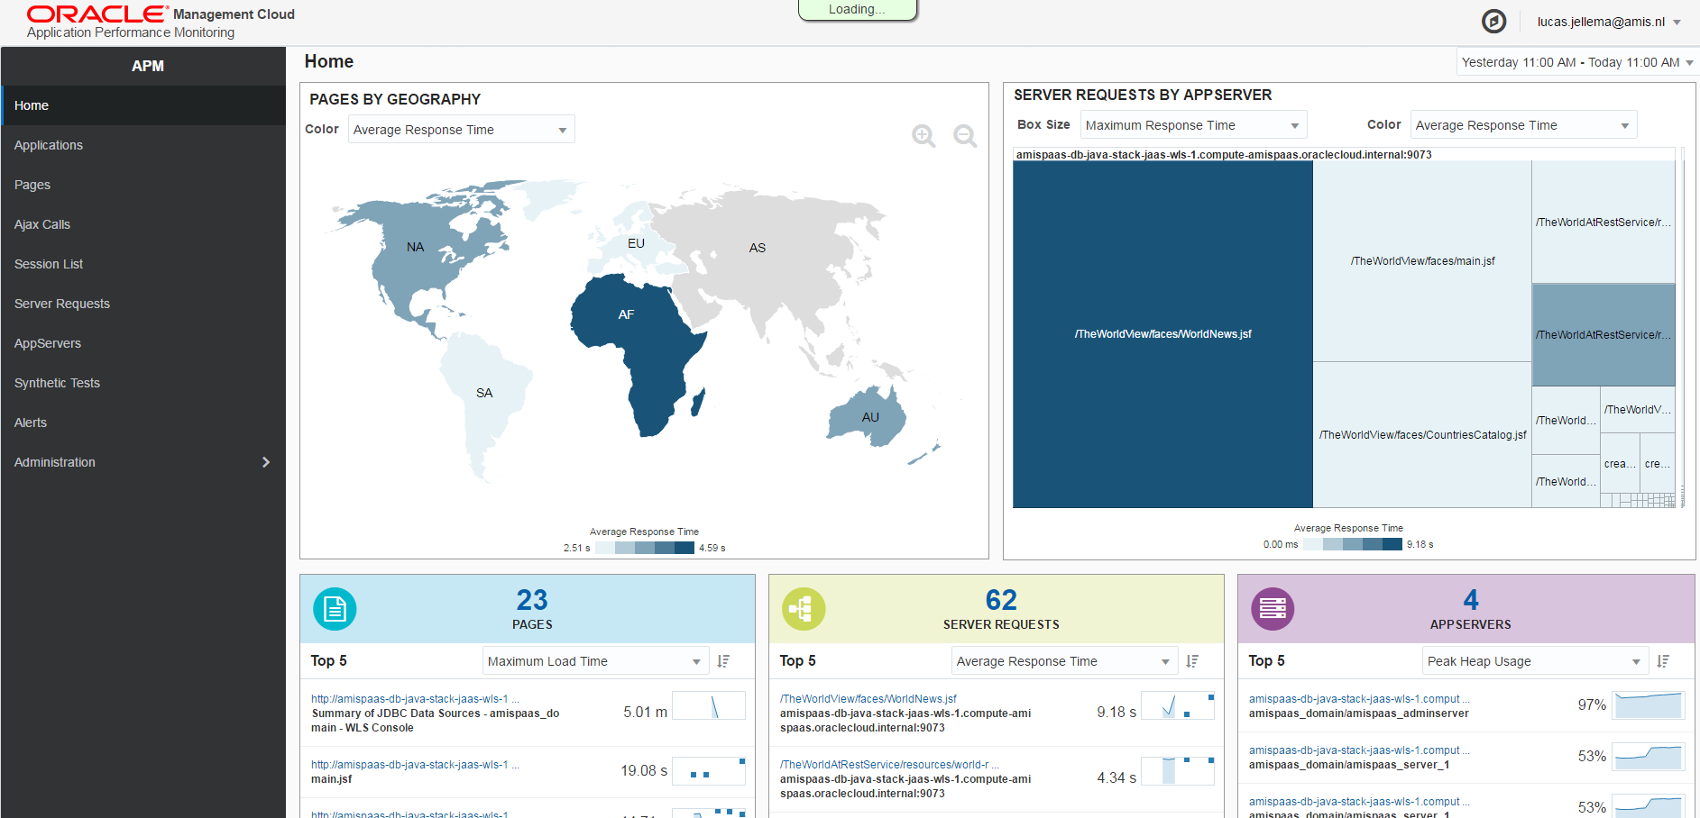
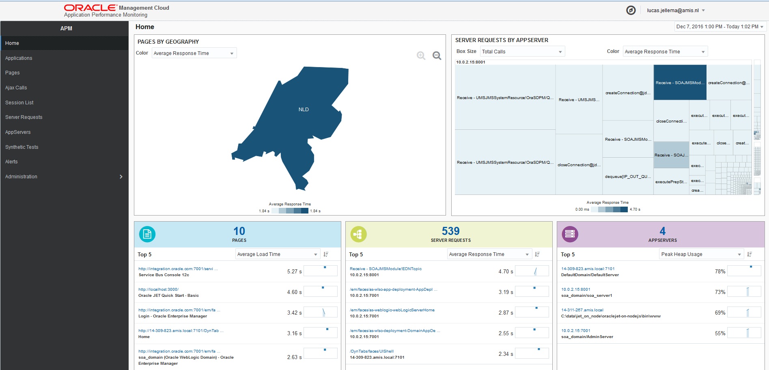



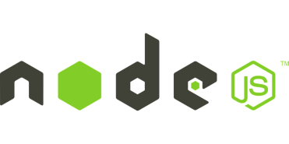
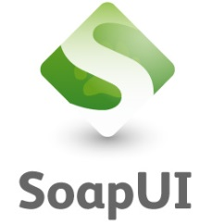
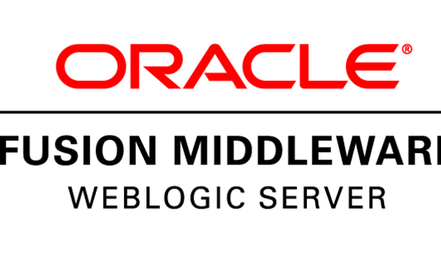
My very first steps with OMC
ADF UI running
in browser
Node.js
APM
Java agent
ADF12c application
APM Node Agent
Service Bus project
BPEL process
APM
Java agent
SOA Suite 12c
Colleague’s Laptop
My Laptop

Slide 15
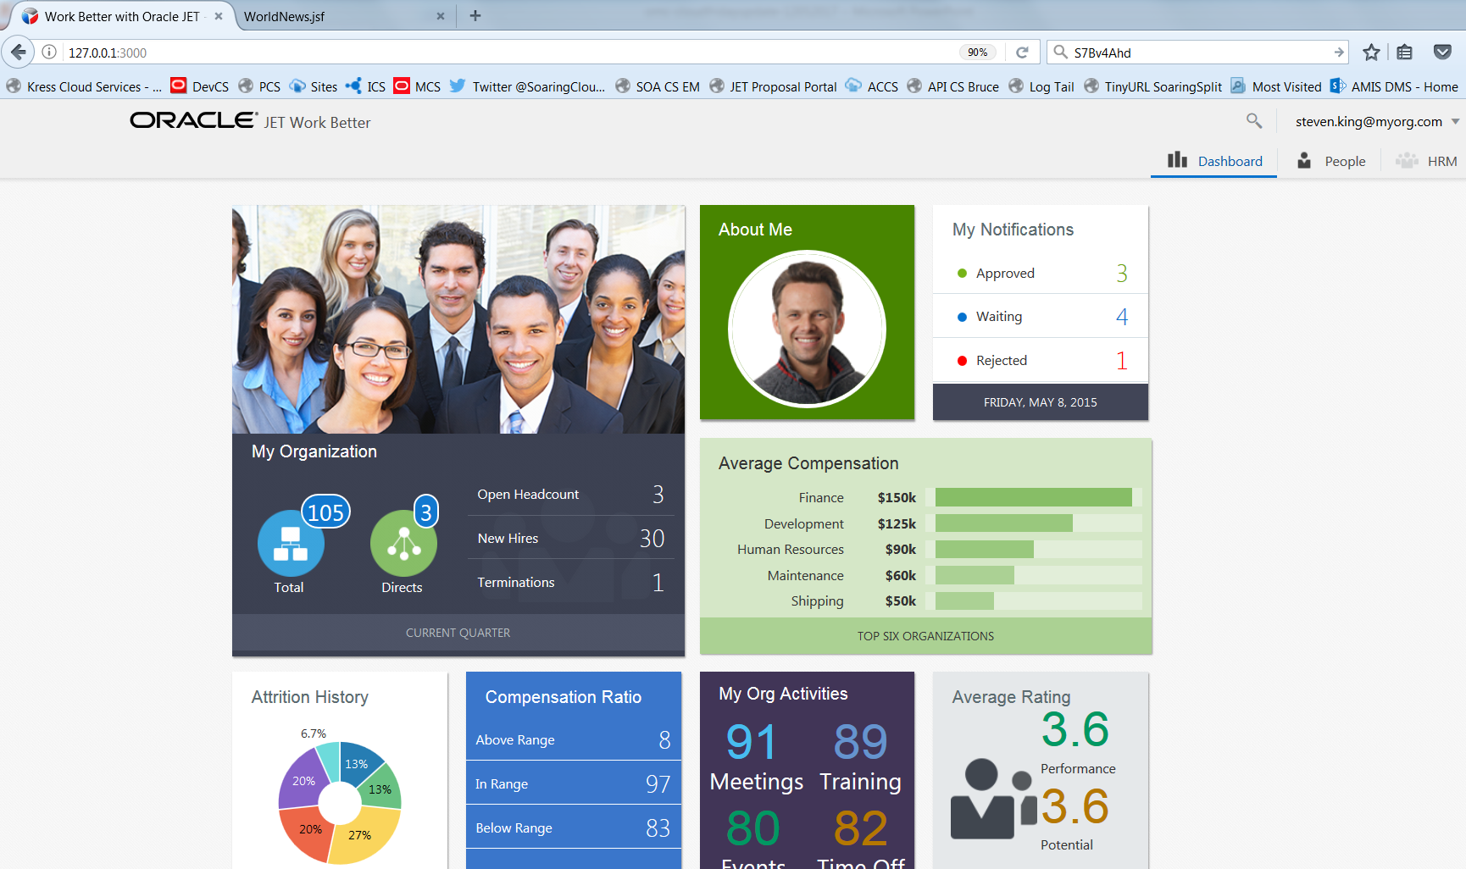
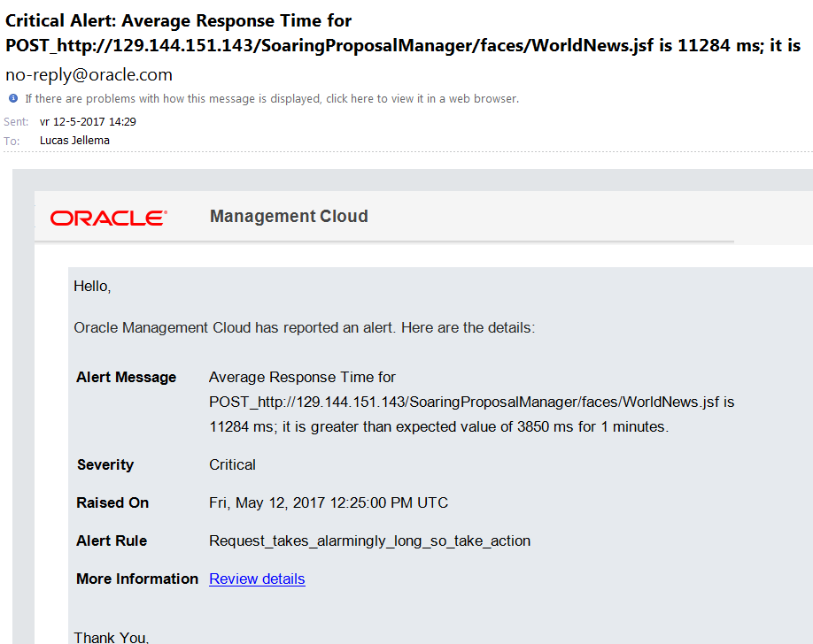
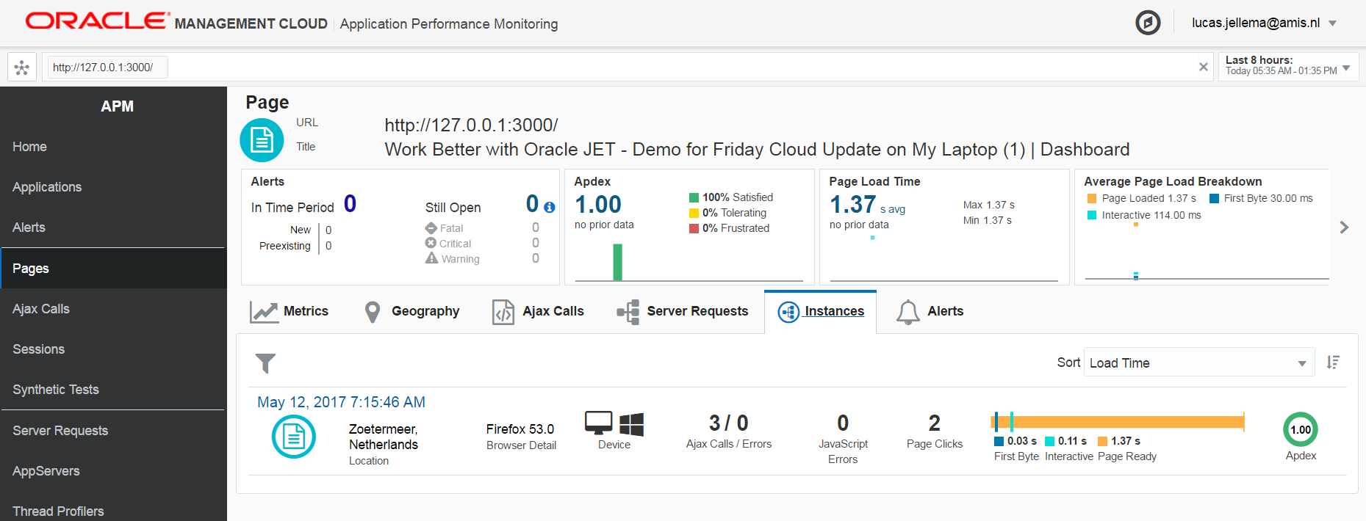
Local demo

Slide 16

Demo in the cloud
DBaaS
ACCS
LA
LA
SOA CS
JCS
BPEL
APM
ADF
LA
APM
LA

Slide 17
APM & Log Analytics - Useful in all stages of software delivery lifecycle
What can we learn about what our users are doing?
Which functionality is being used – when/from where/by whom
What insight do we get about poor performance (sub standard) and errors our users run into?
Dashboard & alerts
How can we enrich application level logging to be able to better understand and analyze run time behavior?
What work instructions can we develop for application administrators (and DevOps team) to investigate issues?
Bonus/Low hanging fruit: find errors and warnings in our application code, improve logging, resolve deployment issues, learn about framework errors, learn about WLS and ADF behavior (package dbms_pickle)
DevOps

Slide 18
Learning points, Rough edges and Obstacles
It is deceptively simple to get going
And not so simple to find out how to extract the most value from what OMC has to offer
Configuring the agents can be very smooth and straightforward
And sometimes requires careful investigation and configuration
APM:
Does not carry business indicators
Not so easy to find a specific user’s session
APM and ADF are not a perfect combination
APM works best on individual pages rather than single/few page applications
APM does not explicitly support API & Service calls – it focuses on UI requests
APM location map could be more detailed: The Netherlands is as granular as it gets

Slide 19
Learning points, Rough edges and Obstacles (2)
Log Analytics:
Logging levels and thresholds have to be configured right in platform
Applications should provide meaningful logging (!)
The link from APM to LA is not perfect (ECID not carried forward)
Log Analytics knows and can parse over 100 log file formats
An API [is | will be] available for programmatically creating LA entries
From platforms/technologies that agents are not available for

Slide 20
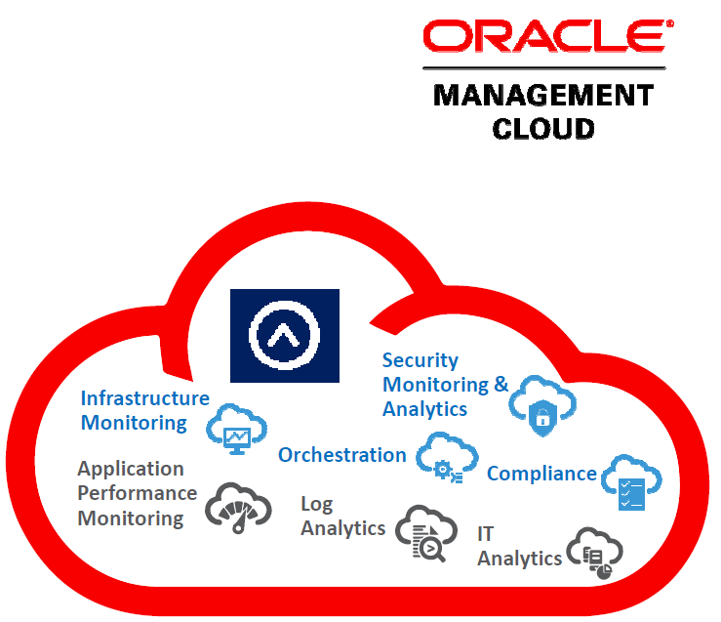
Conclusion
Compelling story – intuitive, clear [business] value
Easy to get started
Across technology stacks, on premises and clouds
Enables operational management – at various levels
Also facilitates [end to end] development
Teaches developers how useful good logging can be
Helps spot issues in platform and applications early on
Great first cloud to embrace - for any organization

Slide 21



Blog: technology.amis.nl
Email: lucas.jellema@amis.nl
: lucasjellema
: lucas-jellema
: www.amis.nl, info@amis.nl +31 306016000 Edisonbaan 15, Nieuwegein

